Slide 1


Bag-of-Words-based
Object Classification
Chi Liu
Carnegie Mellon University
chil1@andrew.cmu.edu
2016.1.4
Loading……
Notes:
chil1@andrew.cmu.edu

Slide 2
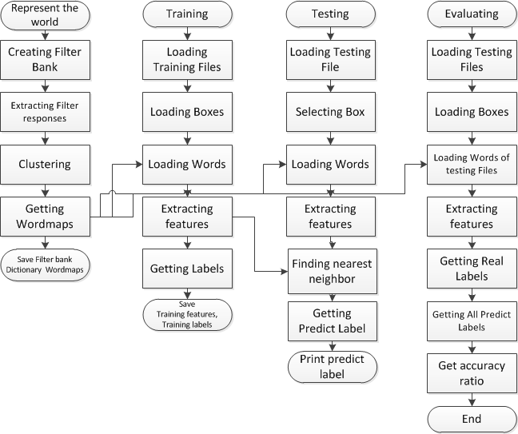
Flow
Flow
Represent the world
Training
Testing
Evaluating
Improvement
*

Slide 3
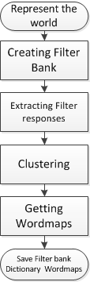
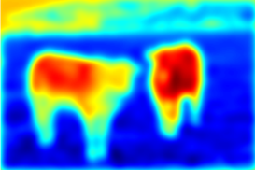
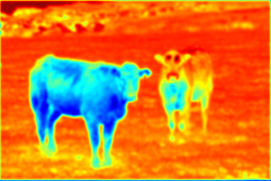
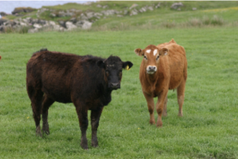
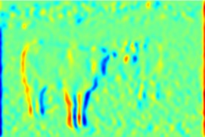
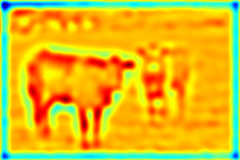
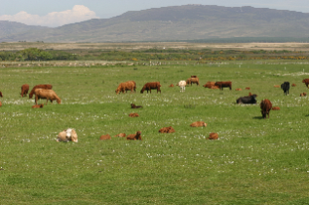
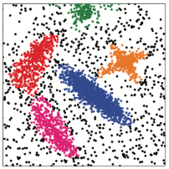
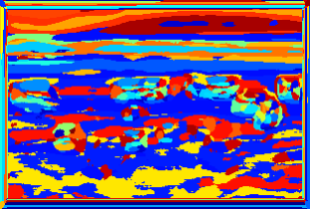
Represent the World
Flow
Represent the World
Training
Testing
Evaluating
Improvement
Figure 1 : An input image, and four filter responses
Figure 2 : Color input, Clustering and map of visual words output
*

Slide 4
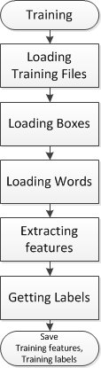



Training
Flow
Represent the world
Training
Testing
Evaluating
Improvement
Figure 3 :Training files
Figure 4 :Loading boxes
sky
cow
grass
Figure 5 :Loading words
Figure 6 :Histograms and labels
*

Slide 5
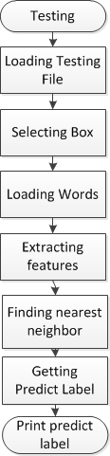
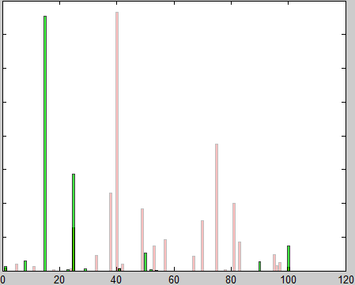
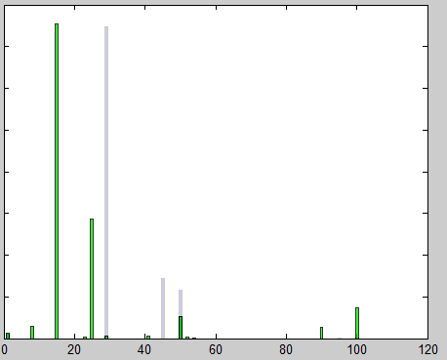
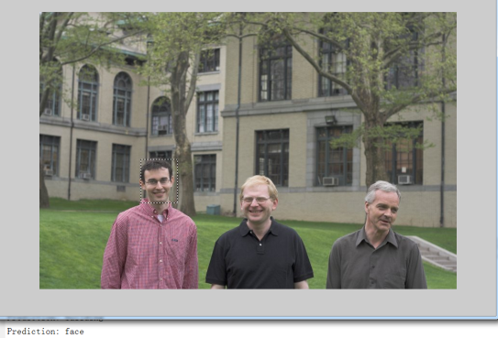
Testing
Flow
Represent the World
Training
Testing
Evaluating
Improvement
Figure 7 : Histogram crossing to find the nearest features
Figure 8 :Predict label
*

Slide 6
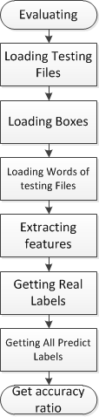
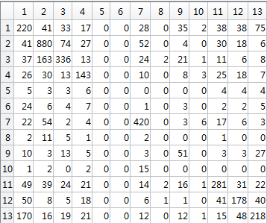

Evaluating
Output Labels
Flow
Represent the World
Training
Testing
Evaluating
Improvement
Input Labels
Accuracy ratio =
Accuracy ratio = 57%
*

Slide 7
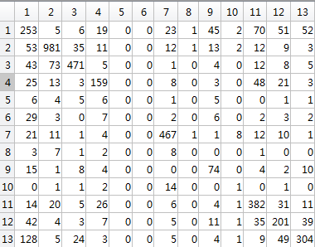
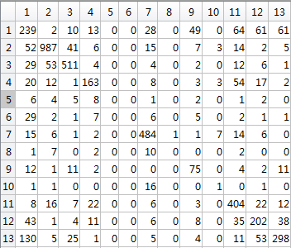
Improvement
Flow
Represent the World
Training
Testing
Evaluating
Improvement
Accuracy ratio = 69%
Accuracy ratio = 71%
We add 3 different filters.
‘sobel’,’average’,’ laplacian’.
Histogram intersection is nice, but there are different distances.
We use Hellinger.
*

Slide 8
THANKS
Chi Liu
Carnegie Mellon University
2016.1.4

